Slide 1

Super Happy Dev Day
Mobile Awesomesauce

Slide 2

Introductions
Hi, my name is Dayel Ostraco
Mobile Evangelist and Señor Tech Lead for SPARC
My site - http://dayelostra.co
GitHub - http://github.com/dostraco
Presentation Stuffs
https://github.com/dostraco/SuperHappyDevDay
Email – dayel.ostraco@sparcedge.com
Notes:
Embrace mobile constraints to focus and prioritize the services we’re designing and building.
Use mobile capabilities to innovate the complete customer experience.
Take what we know about designing for the web and start thinking differently about mobile organization, actions, inputs, and layout.

Slide 3
What we’ll cover
What mobile can do and where it’s going (complete with boring fun stats)
Does Mobile Development differ from standard development?
*SPOILER ALERT*… it totally does
Mobile Development Strategies
Nitty Gritty iOS/Android Phone Gap Lab

Slide 4
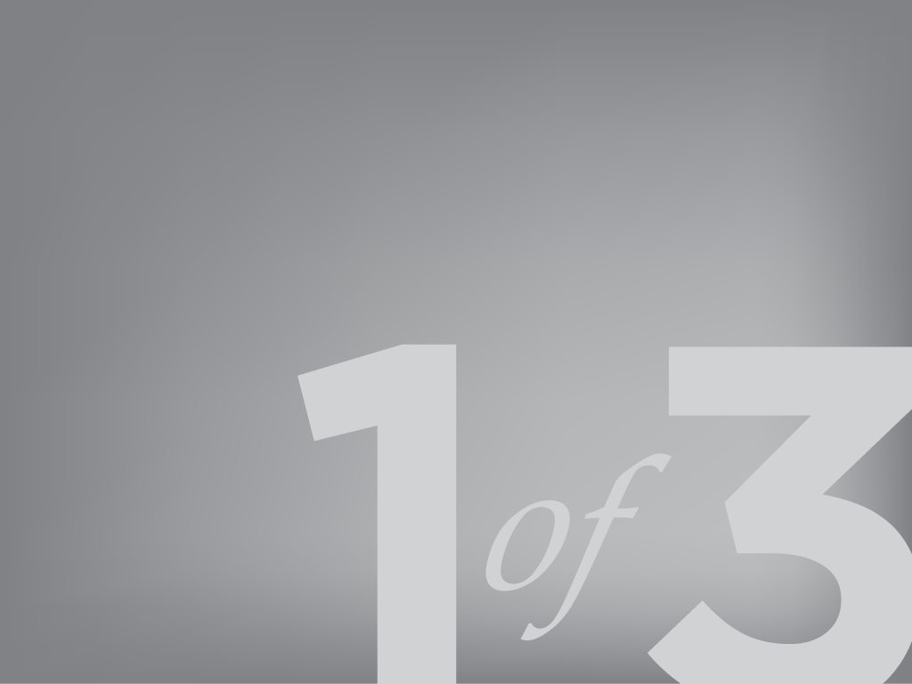
The Mobile Future
“The era of mobile computing… is outpacing both the PC revolution of the 1980s and the Internet Boom of the 1990s.” - Charles Newark-French

Slide 5
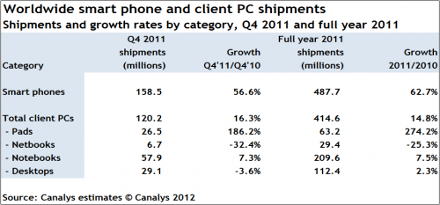
Mobile Growth (Boring Stats)
sources: Canalys
Notes:
More applications will be developed for the Mobile web than PCs.
There are 1.3 million mobile apps today, versus 50,000 to 75,000 PC applications,
Mobile is quickly becoming the preferred choice among users.

Slide 6
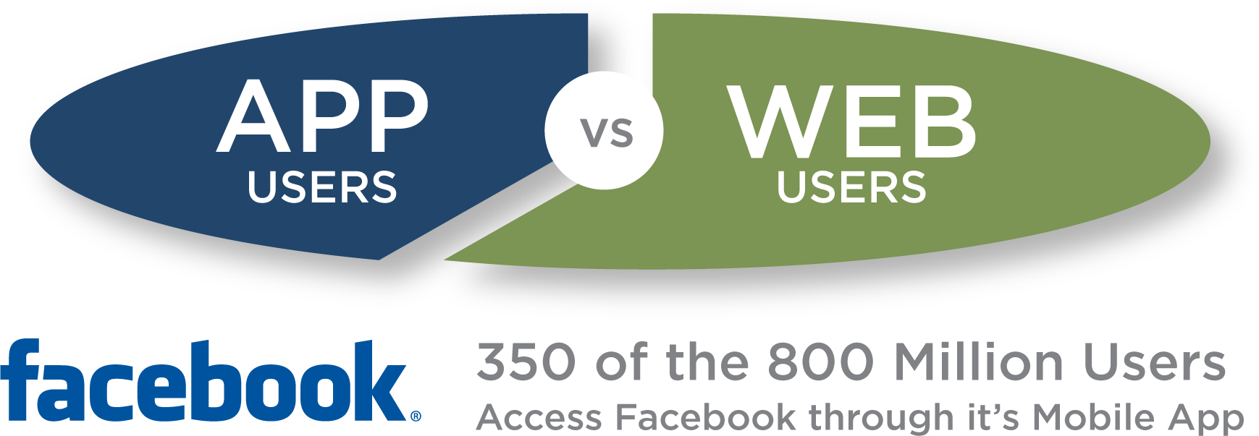
Becoming the preferred experience
source: http://www.facebook.com/press/info.php?statistics
Notes:
Mobile is currently an extension of your application. This may not be true in the future. It is quickly becoming the preferred user experience. Facebook already recognizes this and has already invested heavily in focusing their entire platform on mobile.
Facebook app
More than 800 million active users, 350 million through the Mobile App (insert diagram BK)

Slide 7
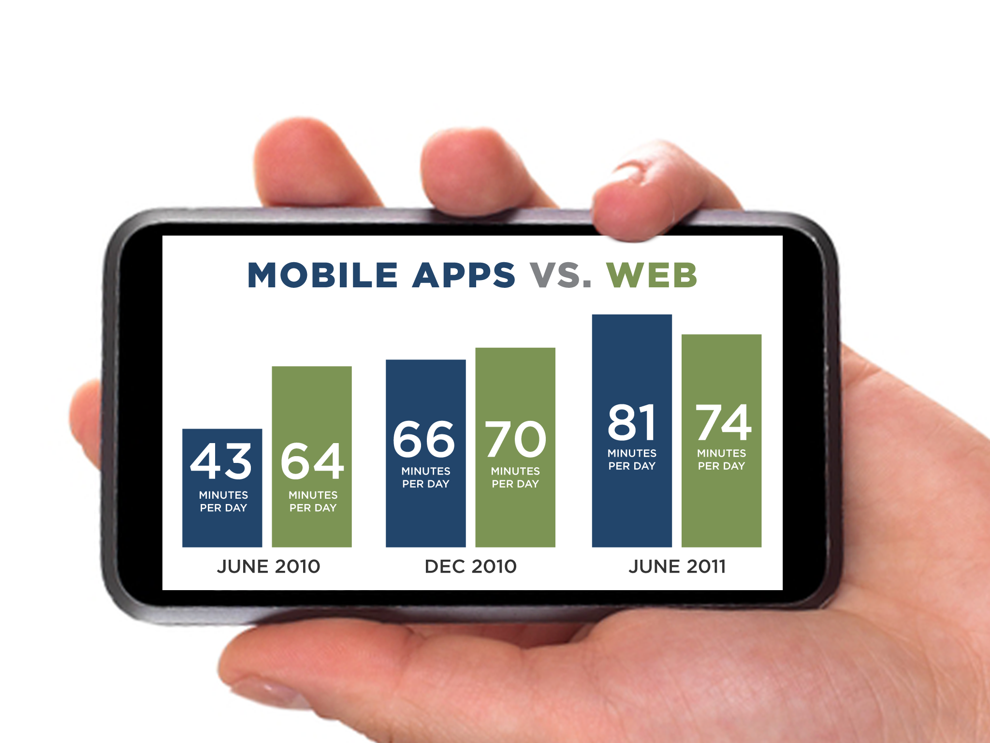
Mobile Apps or Web?
sources: comScore, Alexa, Flurry Analytics
Notes:
More applications will be developed for the Mobile web than PCs.
There are 1.3 million mobile apps today, versus 50,000 to 75,000 PC applications,
Mobile is quickly becoming the preferred choice among users.

Slide 8
Sensory Perception
Touch
Camera(s)
Gyroscope
Location (GPS, WiFI, Carrier Tower)
Compass
Audio
Bluetooth Communication

Slide 9
Sensory Overload?
Near Field Communication
Ambient Light
Proximity
Barometer
Thermometer
Augmented Reality
Haptic Feedback

Slide 10
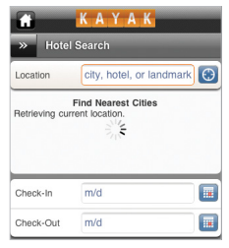
Location services
Notes:
An example of simplifying the user interface to pre-populate fields based on the native GPS location services. Kayak can find the nearest hotels based on your current location without unnecessary taps and keyboard inputs.

Slide 11
Location Services
Carrier Towers (Accuracy within ~1000m+)
WiFI Signal (Accuracy within ~200m)
GPS (Accuracy within ~10m)
HTML5 support means it’s not just for Native
*Expect more accurate GPS location soon!
http://www.ted.com/talks/todd_humphreys_how_to_fool_a_gps.html

Slide 12
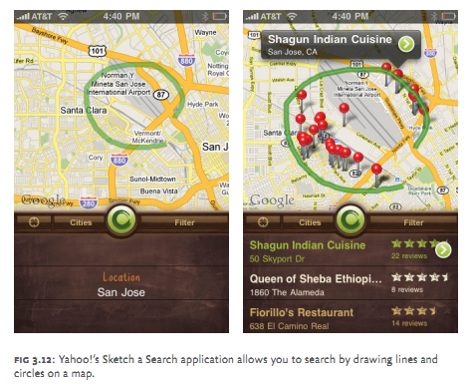
Custom Map Interactions
Notes:
Yahoo Maps has very creatively created a simple interface for locating points of interest on a Map based on the user’s location. Rather than fumbling with a keyboard input, a user can simply draw any shape around an area of the map they are interested in and get all points of interest located within that drawn shape. You can glean a lot of information about an area with one swipe of the thumb.

Slide 13
Custom Map Interactions - iOS
QuartzCore and CoreGraphics
MapKit with a UIBezierPath view overlay
Notes:
Yahoo Maps has very creatively created a simple interface for locating points of interest on a Map based on the user’s location. Rather than fumbling with a keyboard input, a user can simply draw any shape around an area of the map they are interested in and get all points of interest located within that drawn shape. You can glean a lot of information about an area with one swipe of the thumb.

Slide 14
Haptic Feedback
Heighten the User Experience
Just for games?
Android and Windows Phone only. Apple soon?
http://www.immersion.com/developers/
Notes:
Used mostly for games, but think about using it for your buttons or environment interactions.

Slide 15
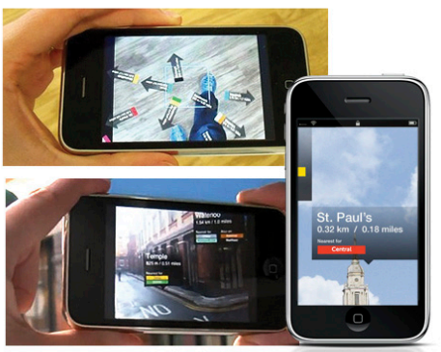
Augmented Reality
Notes:
The London Underground has developed a Camera Overlay that makes use of your location Data via GPS services. It will overlay arrows pointing to the nearest stations via your camera display. This is an incredibly inventive way to direct users to the nearest station while also giving them insight into the Line the subway operates on.
Useful Libraries
http://code.google.com/p/andar/
https://developer.qualcomm.com/mobile-development/mobile-technologies/augmented-reality

Slide 16
Augmented Reality
Kitsch or the future?
Google Glasses, Yelp, Layar and First Person UI’s
https://github.com/zac/iphonearkit/
https://github.com/haseman/Android-AR-Kit
https://developer.qualcomm.com/mobile-development/mobile-technologies/augmented-reality
http://www.lukew.com/presos/preso.asp?21

Slide 17
What have we learned?
Mobile is totally awesomesauce.
It’s likely not a fad.
Mobile allows us to interact with our environment in new ways.
It’s rapidly evolving.
It’s overtaking PC in sales and usage.
Notes:
Mobile Devices are changing the way we develop. Mobile use may usurp desktop/laptop use as the preferred experience.
Applications are no longer monolithic apps that do everything. Applications are now smaller, hyper focused and unchained by location.
In mobile, the application is the sum of all its parts and those parts are the hyper focused individual apps.
Future development may sidestep the large desktop experience with mobile as the augmenter, to a Mobile first approach.
How do we evolve to a new development landscape that requires rapidly deploying smaller plank applications?

Slide 18
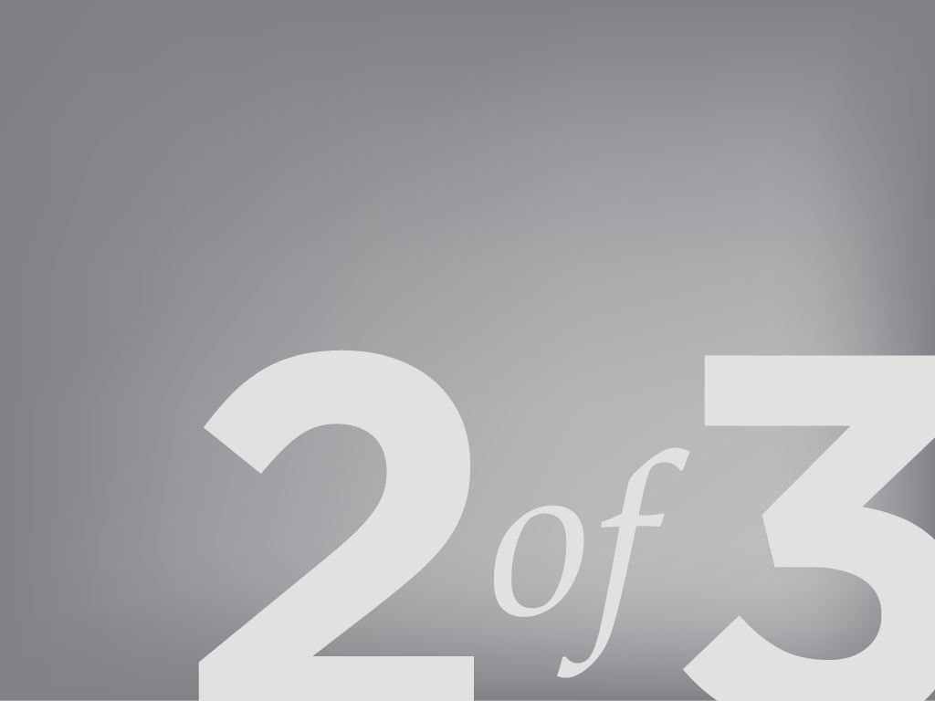
Mobile is Different and the Same
“Mobile represents a perfect confluence of technological change and our environment. Being an engineer during this wave means we get to radically shape the world in more powerful ways then the PC ever did.”

Slide 19
Mobile is Different and the Same
“Mobile represents a perfect confluence of technological change and our environment. Being an engineer during this wave means we get to radically shape the world in more powerful ways then the PC ever did.” - Dayel Ostraco
^
That’s ME!

Slide 20
Focused Domain
The Environment is your frenemy
“One Eye, One Thumb”
Hyper Focused Content/Functionality
Leverage sensors sensors to streamline the user experience (and make it waaaaaaaay more immersive)
Same Architecture, Different Focus
Notes:
A mobile app is not as simple as porting your enterprise application on a mobile device. A mobile device provides a totally different user experience that requires you to boil down your content and functionality to it’s basest components. Mobile users use mobile apps in completely different way. Being mobile means that there are environmental factors that split the user’s focus. When developing on mobile, you need to be aware of these environmental distractions and plan for your user to only be using one eye and one thumb.

Slide 21
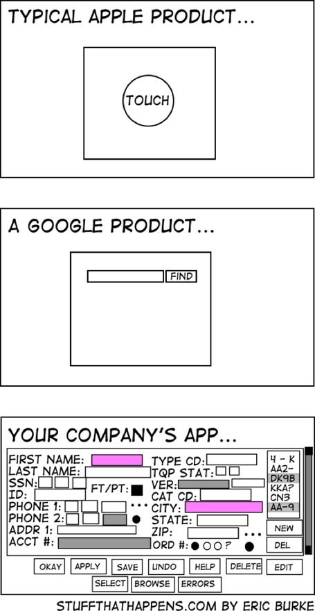
Notes:
A mobile app is not as simple as porting your enterprise application on a mobile device. A mobile device provides a totally different user experience that requires you to boil down your content and functionality to it’s basest components. Mobile users use mobile apps in completely different way. Being mobile means that there are environmental factors that split the user’s focus. When developing on mobile, you need to be aware of these environmental distractions and plan for your user to only be using one eye and one thumb.

Slide 22

The Environment is your FRENEMY

Slide 23
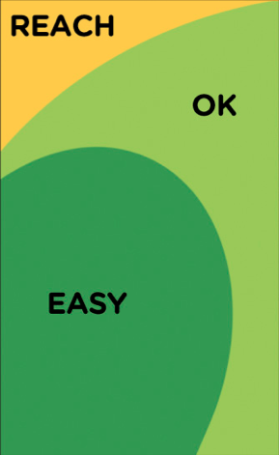
“One Eye, One Thumb”

Slide 24

Hyper-Focused Experience

Slide 25
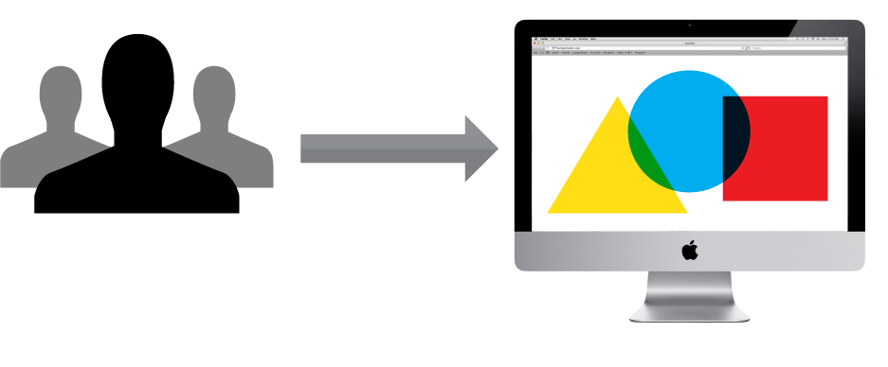
Enterprise Web Application
Notes:
Your Typical web application needs to do many things and fit many users. It involves planning, understanding user needs, large timelines & development teams to satisfy this.

Slide 26
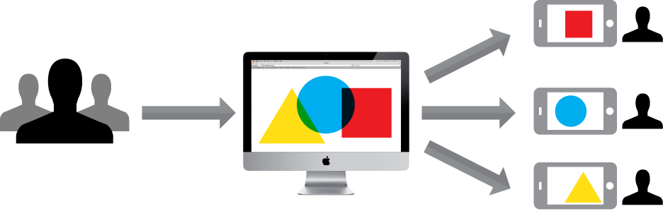
Web Application vs. Mobile Apps
Notes:
An App seeks not to do everything, but focus on just what the each user actually needs. The total sum of all mobile applications is the whole enterprise application with a tailored user experiences. Think of what you really want to do on your banking app.

Slide 27
Use yo sensors
No longer limited to clicks and key presses.
Reduce 20 clicks to a gesture, swipe, tilt, point, shoot, speak, touch, feel, notification, push, pull, bump, beam, draw and whatever else comes along.
Interact with your user and their environment
Notes:
The Native capabilities of mobile devices opens up a whole slew of new interactions. New functionality on the horizon is ambient light detection and NFC.

Slide 28
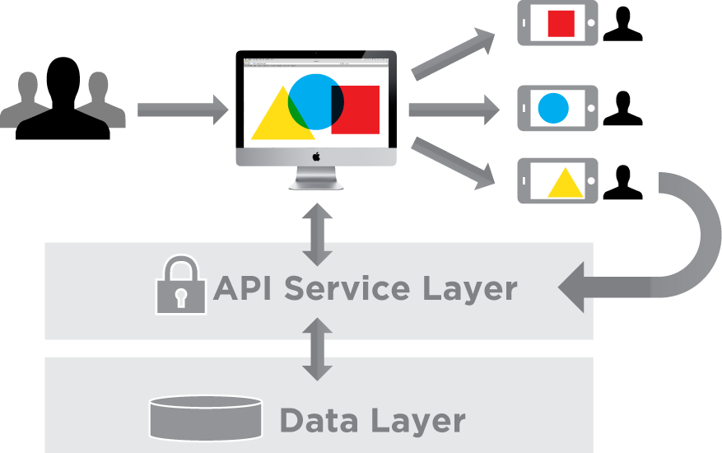
Same Architecture, Different focus.
Notes:
Apps connect the same way applications do. They can use the same web security to access Services, Databases & information as a web application. In this manner, your Domain Focused mobile applications extend you web application in new and personalized ways.

Slide 29
When designing for mobile
Focus & prioritize the services
Innovate the user experience
Start thinking differently:
Continuously reduce domain per application
Content organization – what’s important
New user interactions
Pre-populate information (AKA Location from GPS)
The user’s external environment is your friend (and your enemy)
Notes:
Embrace mobile constraints to focus and prioritize the services we’re designing and building.
Use mobile capabilities to innovate the complete customer experience.
Take what we know about designing for the web and start thinking differently about mobile organization, actions, inputs, and layout.

Slide 30
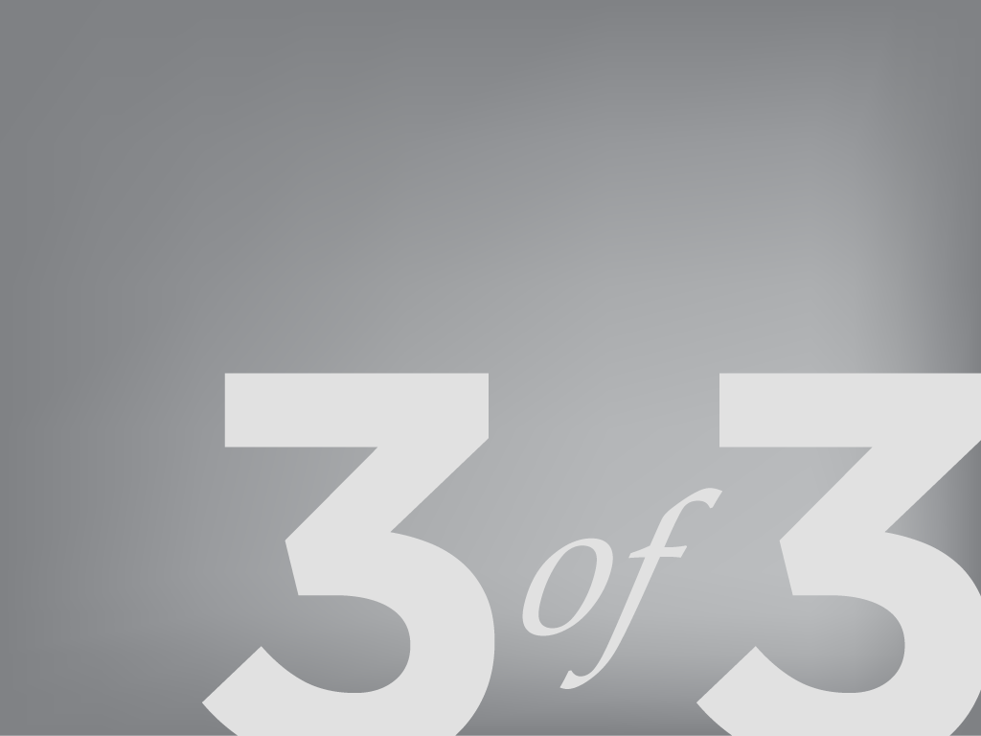
Mobile Development Strategies
So mobile is great and all… but where do I start?
Notes:
Engaged employees are the creative force behind everything good that happens in an organization.
http://gmj.gallup.com/content/150710/High-Energy-Workplaces-Save-America.aspx?utm_source=email&utm_medium=012012&utm_content=titlelink&utm_campaign=newsletter#2

Slide 31
The Landscape
There are several strategies available.
We’ll break down the four that I know of
Pure Mobile Web
Pure Native
Mobile Web Apps
Hybrid Apps

Slide 32
Pure Mobile Web
Responsive Web Design (will blow your mind)
Leverage CSS3 @Media Queries
Build site that can conform to multiple devices and resolutions
Build your site’s styles for mobile devices FIRST, then extend your styles for the desktop.
You MUST read Responsive Web Design and Mobile First!!

Slide 33
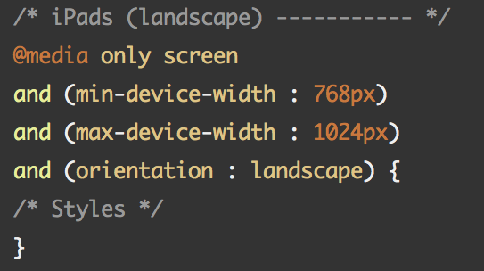
@Media Query

Slide 34
Mobile Web
Pros
Your site or web application is optimized for ALL devices and desktop resolutions
You’ll get a TON of street cred
Can become a standalone Native app through Web Views (will explain later)
Basic location services
HTML5 Local storage kinda like a Database
No need to download or version

Slide 35
Mobile Web
Cons
Your site or web application is optimized for ALL devices and desktop resolutions (not a typo... if you do it right)
Very limited Native capabilities
Cannot, by itself, be a downloadable app
Much harder to monetize
No OpenGL but hopefully WebGL through the HTML5 canvas soon.

Slide 36
Mobile Web Examples
gmail.com
twitter.com
bostonglobe.com
starbucks.com
dreamforce.com (seriously check this one out)
Check out Twitter Bootstrap for your sites!

Slide 37
Native Apps
Pros
Leverage the entirety of a devices capabilities
Easier to monetize
Smoothest User Experience
Most immersive User Experience
Background Services
Push Notifications
Widgets
OpenGL!!!
So much cooler (from an Engineer’s perspective)

Slide 38
Native Apps
Cons
Shallow talent pool of developers
4 platforms, 4 development efforts
Longer development time (sometimes)
Expensive

Slide 39
Native Apps Examples
Almost every mobile game out there
Most apps (will make sense in a second… seriously, wait for it…)

Slide 40
Mobile Web App Frameworks
Phone Gap (now Apache Cordova)
Pros
Opens up a serious subset of Native capabilities
Deeper Talent Pool
Much quicker development time
Leverages HTML5, CSS3 and JavaScript
4 platforms, 1 development effort
Easier Maintenance
Open Source

Slide 41
Mobile Web App Frameworks
Phone Gap (now Apache Cordova)
Cons
Not all sensors are represented
Not as smooth as Native
Effort required to make it not look like a Phone Gap app
Does not play well with Native Code
iOS : No Core Data ☹

Slide 42
Other Mobile Web App Frameworks
jQuery Mobile
Awesome, free and Open Source
Appcelerator’s Titanium
Pretty cool, but proprietary and expensive
Sencha Touch
Also pretty cool. Cheaper alternative to Titanium.
Free for up to 5000 users.
Tiggzi
Hella cool cloud-based mobile web app IDE
Uses Apache Cordova (PhoneGap)

Slide 43
Mobile Web App Examples
Wikipedia
Untappd
BBC Olympics
HealthTap

Slide 44
Hybrid Apps
Native experience with dynamic web content
Pros
Get your native on
Smoother user experience
Web Views can re-leverage your already existing web content
Really, really flexible
Cost efficiency in between Mobile Web Apps and Full native

Slide 45
Hybrid Apps
Cons
Still requires four separate development efforts for the app itself, but not the content.

Slide 46
Hybrid App Examples
Flipboard
Instagram
LinkedIn
Facebook
Yelp

Slide 47
To conclude…
Mobile use may soon usurp desktop/laptop use as the preferred experience.
Future development may sidestep the large desktop experience with mobile as the augmenter, to a Mobile first approach.
Mobile Devices are changing the way we develop.
There are many ways to develop for mobile, but let your application requirements be your guide.
Notes:
Mobile Devices are changing the way we develop. Mobile use may usurp desktop/laptop use as the preferred experience.
Applications are no longer monolithic apps that do everything. Applications are now smaller, hyper focused and unchained by location.
In mobile, the application is the sum of all its parts and those parts are the hyper focused individual apps.
Future development may sidestep the large desktop experience with mobile as the augmenter, to a Mobile first approach.
How do we evolve to a new development landscape that requires rapidly deploying smaller plank applications?

Slide 48
Finally… It’s Lab Time!
We’re going to create an App using Phone Gap
Android Geeks
Nothing to install
iOS Fanboys
http://docs.phonegap.com/en/2.0.0/guide_getting-started_ios_index.md.html#Getting%20Started%20with%20iOS
git clone https://github.com/dostraco/SuperHappyDevDay.git
Notes:
Mobile Devices are changing the way we develop. Mobile use may usurp desktop/laptop use as the preferred experience.
Applications are no longer monolithic apps that do everything. Applications are now smaller, hyper focused and unchained by location.
In mobile, the application is the sum of all its parts and those parts are the hyper focused individual apps.
Future development may sidestep the large desktop experience with mobile as the augmenter, to a Mobile first approach.
How do we evolve to a new development landscape that requires rapidly deploying smaller plank applications?

Slide 49
A Quick Plug for SPARC
SPARC
We build AWESOME stuffs
3 Flavors - Commercial, Federal/Defense and Product Development
85% of us are Engineers
Come follow the talent!
http://www.sparcedge.com/careers/working-at-sparc/
Notes:
Mobile Devices are changing the way we develop. Mobile use may usurp desktop/laptop use as the preferred experience.
Applications are no longer monolithic apps that do everything. Applications are now smaller, hyper focused and unchained by location.
In mobile, the application is the sum of all its parts and those parts are the hyper focused individual apps.
Future development may sidestep the large desktop experience with mobile as the augmenter, to a Mobile first approach.
How do we evolve to a new development landscape that requires rapidly deploying smaller plank applications?

Slide 50
Questions?
My site - http://dayelostra.co
My Email – dayel.ostraco@sparcedge.com
My GitHub - http://github.com/dostraco
Presentation Stuffs
https://github.com/dostraco/SuperHappyDevDay
Notes:
Mobile Devices are changing the way we develop. Mobile use may usurp desktop/laptop use as the preferred experience.
Applications are no longer monolithic apps that do everything. Applications are now smaller, hyper focused and unchained by location.
In mobile, the application is the sum of all its parts and those parts are the hyper focused individual apps.
Future development may sidestep the large desktop experience with mobile as the augmenter, to a Mobile first approach.
How do we evolve to a new development landscape that requires rapidly deploying smaller plank applications?

